Slide 1
Evaluation and Enhancement of Artificial Potential Fields for Path Planning in Dynamic Environments
Bachelorarbeit Präsentation
Niklas Hellmann
Fachbereich 10 Mathematik und Informatik

Slide 2
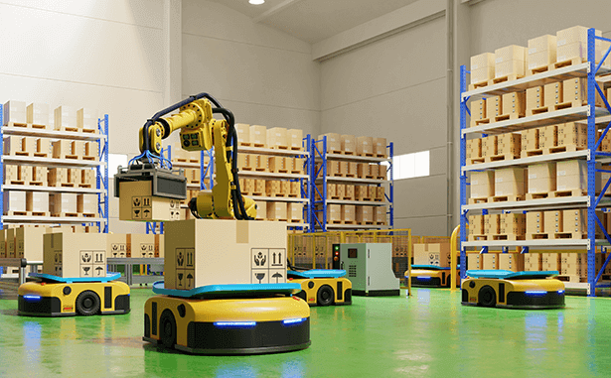
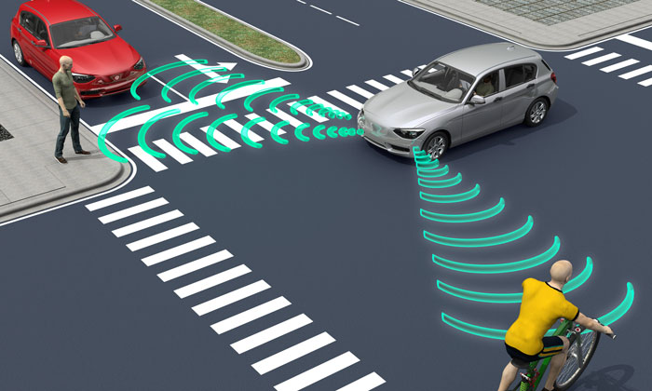
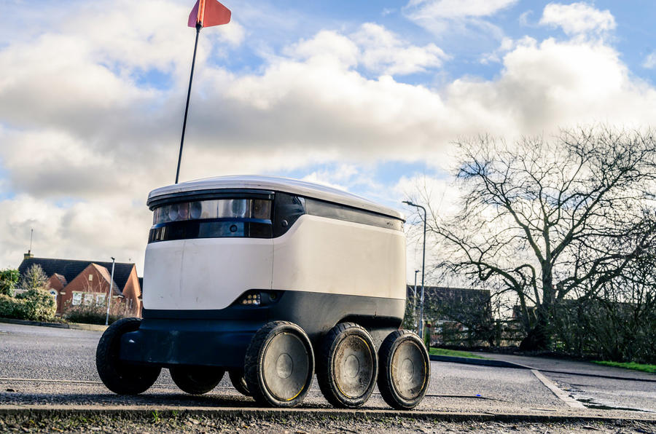
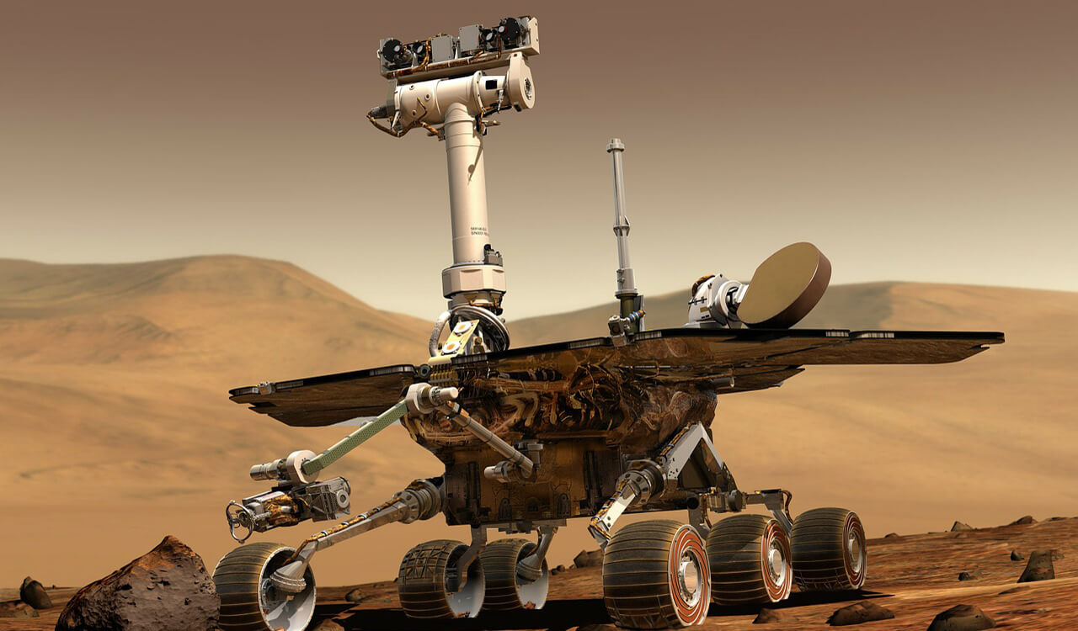
Topic?

Slide 3
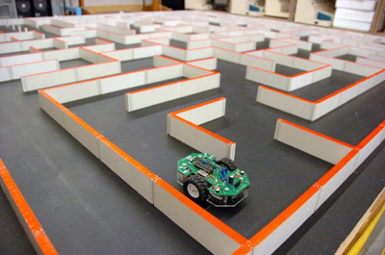

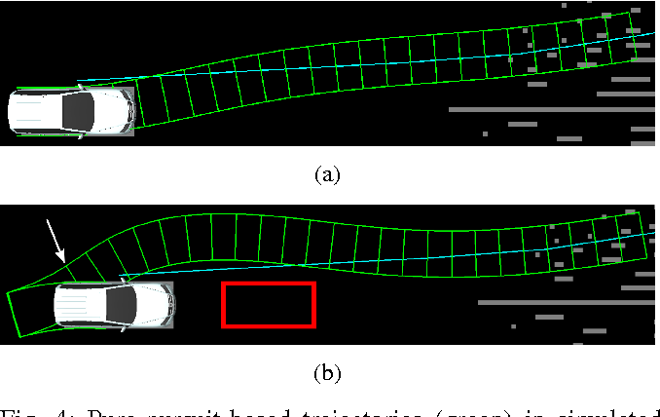
Path Planning?

Slide 4
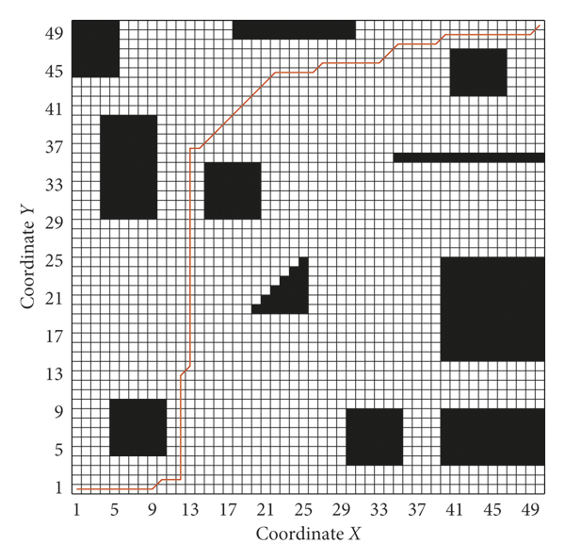
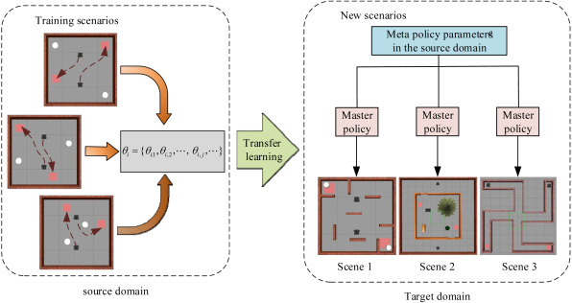
Path Planning
Graph Theorie:
Dijkstra
A*
BFS/DFS
Machine Learning:
Reinforment Learning
Supervised Learning

Slide 5
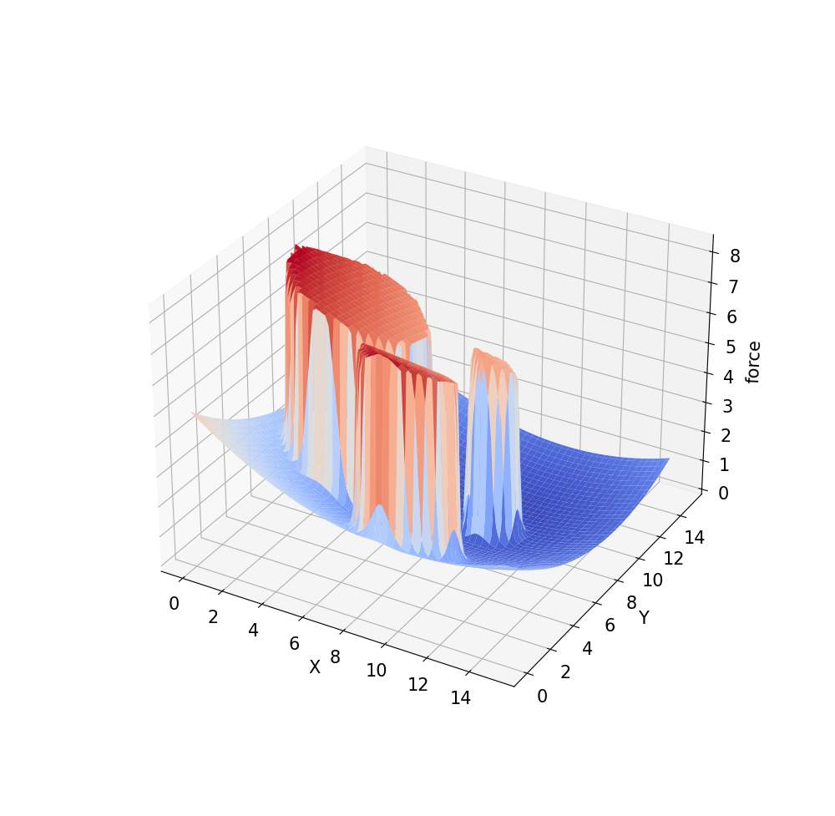
Artificial Potential Field
O. Khatib in 1985
two types of forces:
attraction
repulsive

Slide 6
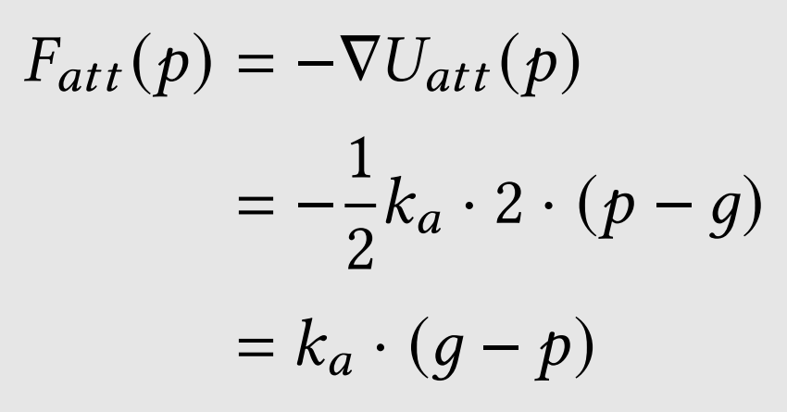
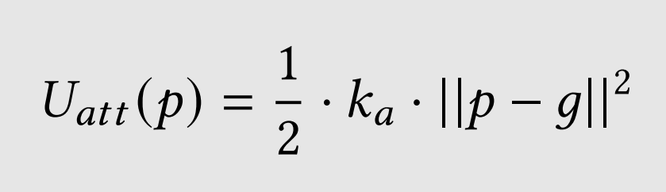
Attraction Field

Slide 7
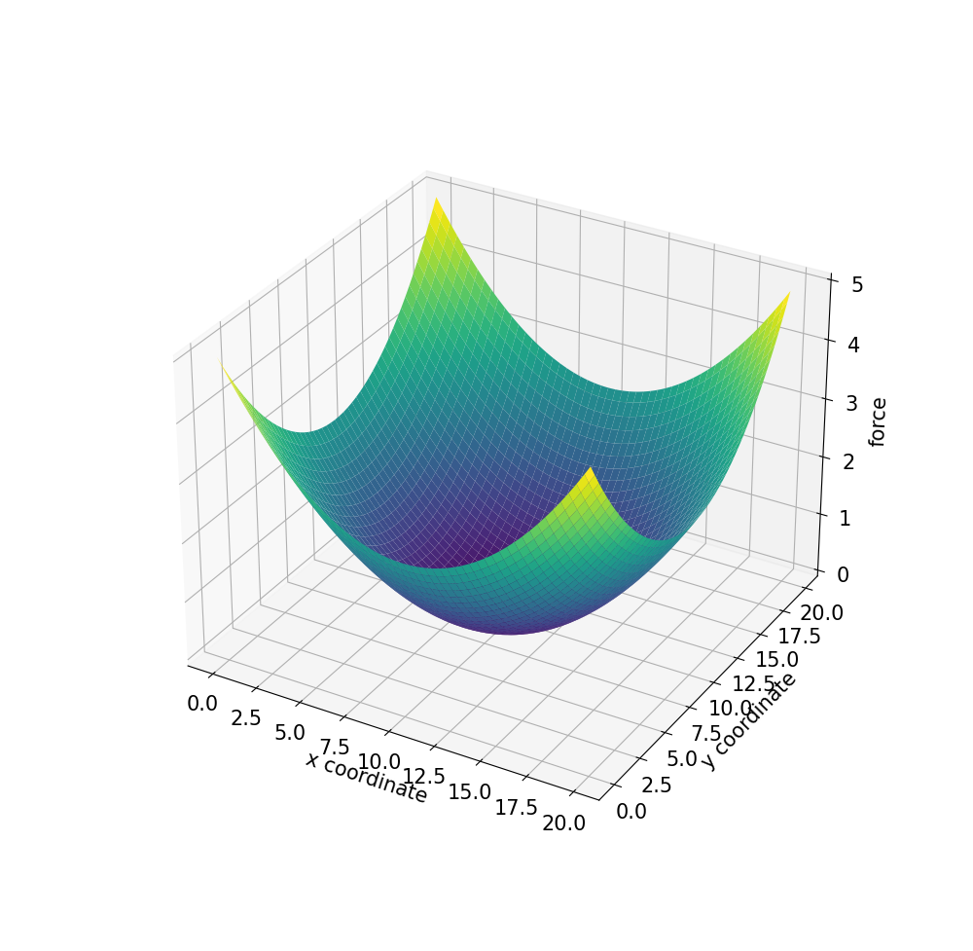
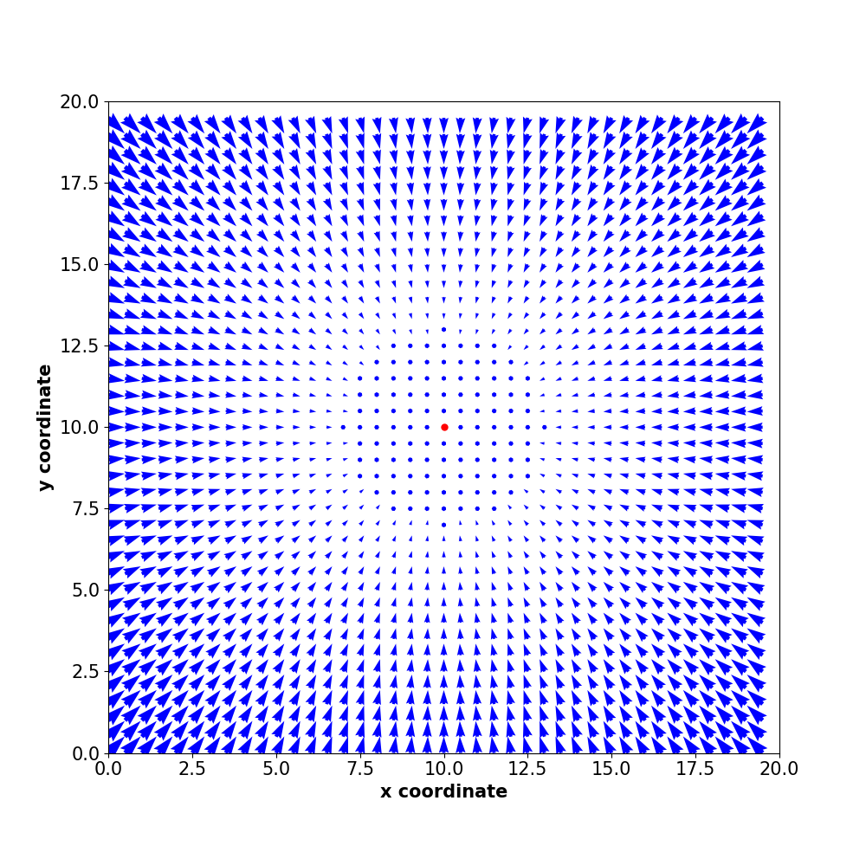
Attraction Field

Slide 8
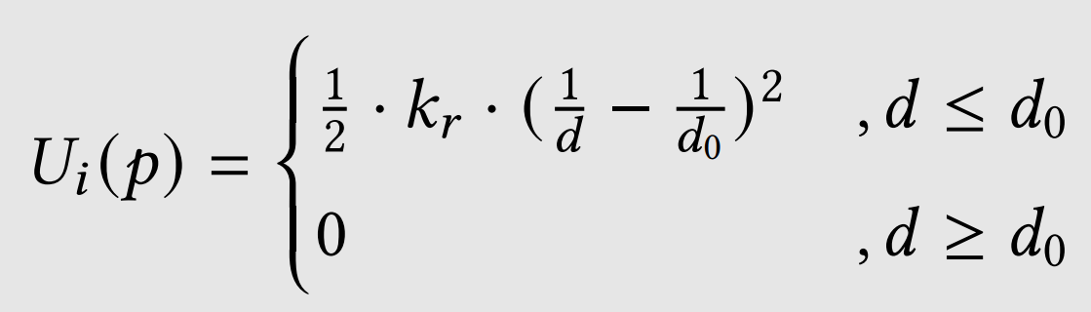
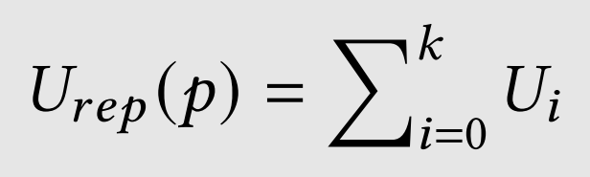
Repulsive Field

Slide 9
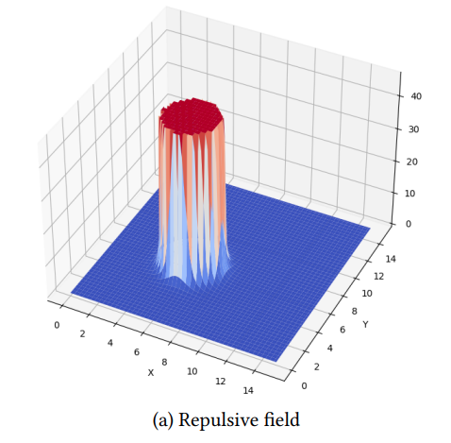
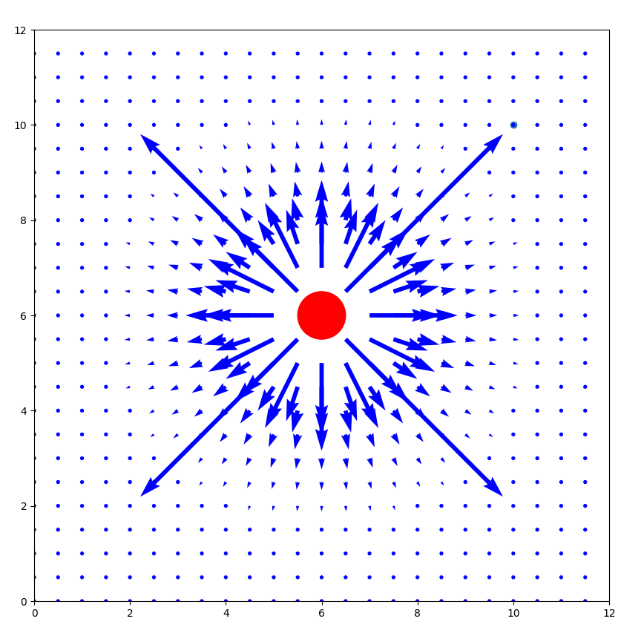
Repulsive Field

Slide 10
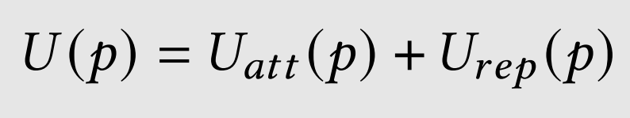
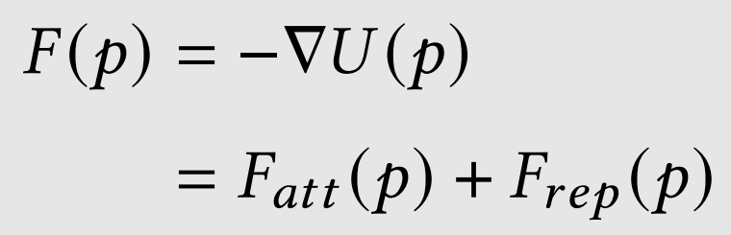
Potential Field

Slide 11
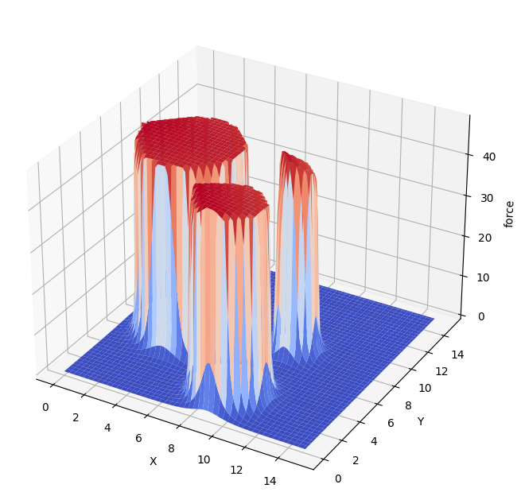


Potential Field

Slide 12
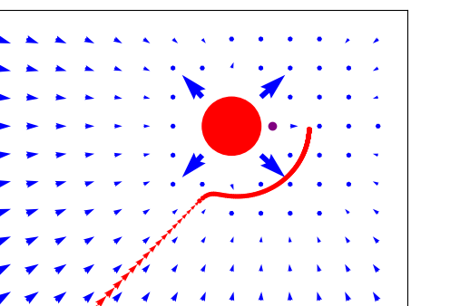
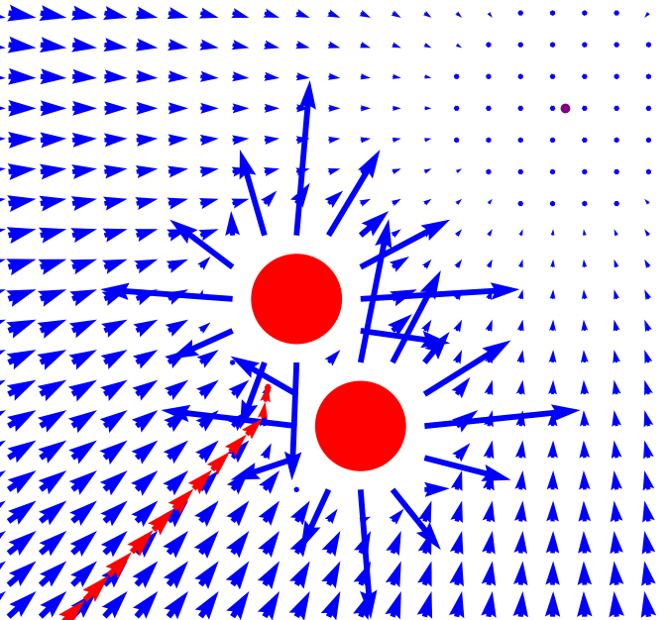
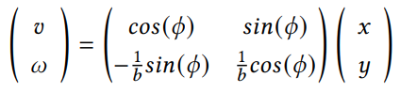
Remarks
Limitations:
Local Minima
Obstacle nearby Goal not reachable
….
adjust vectors to controls

Slide 13
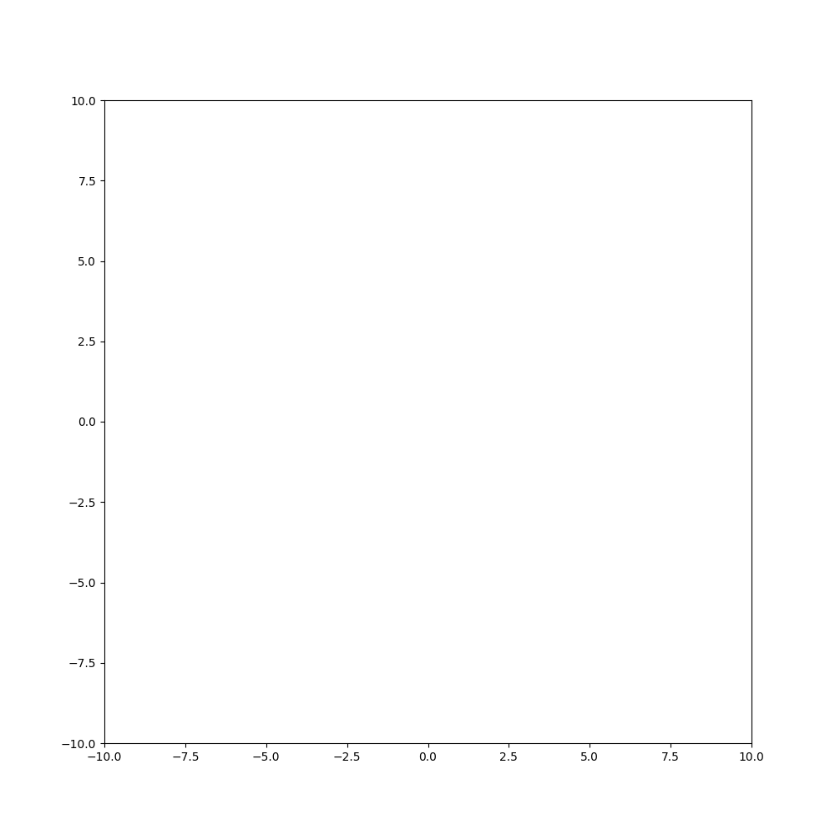
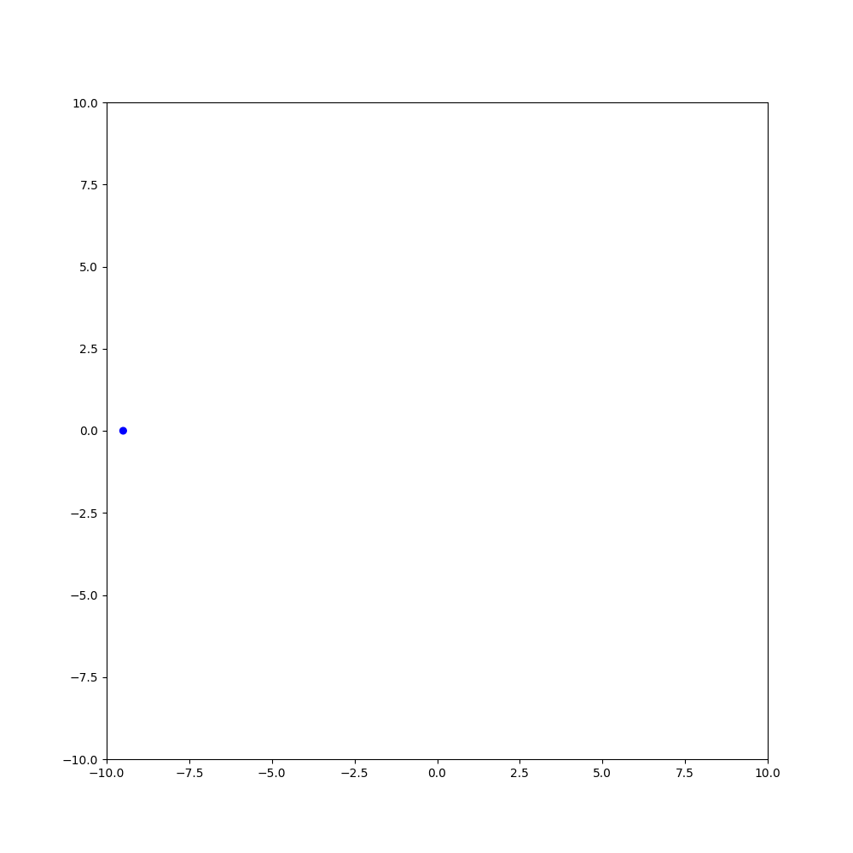
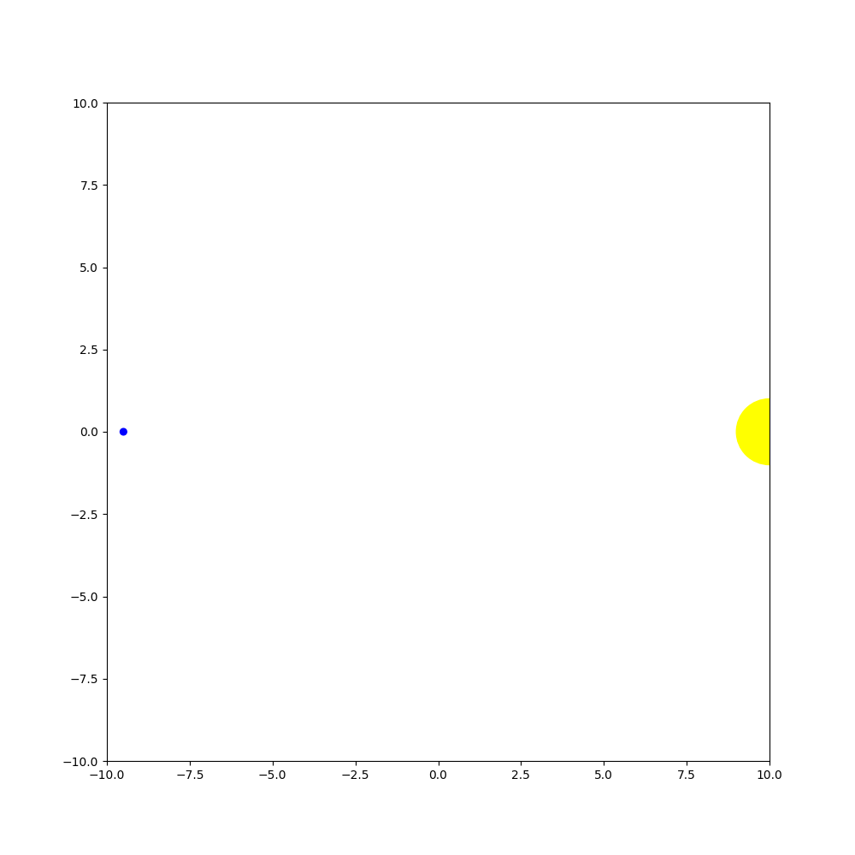
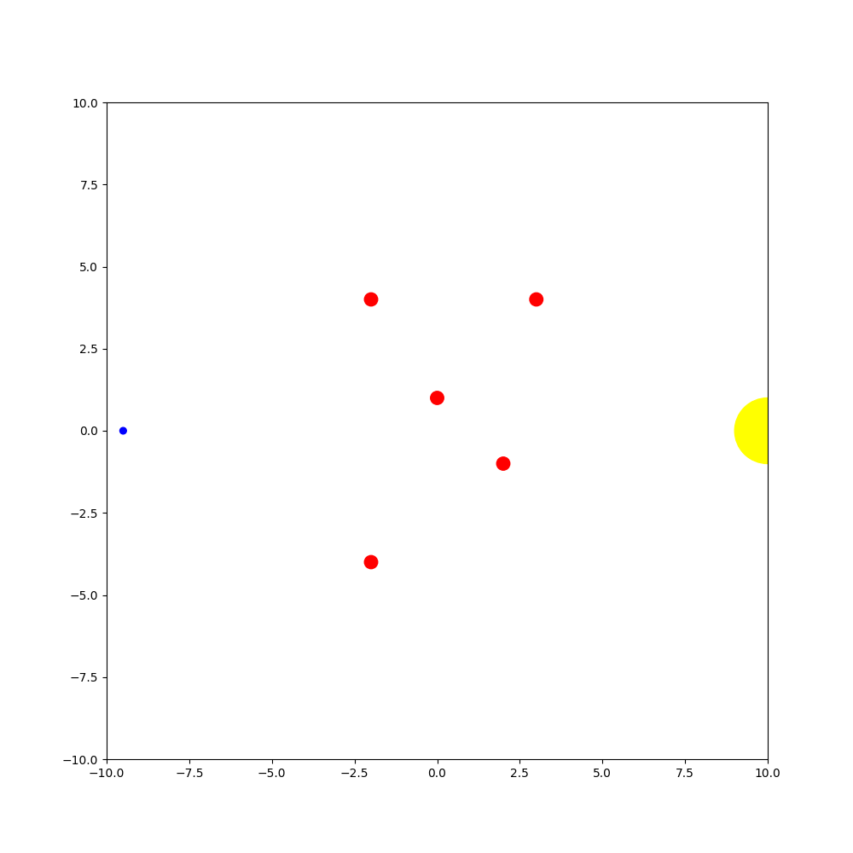
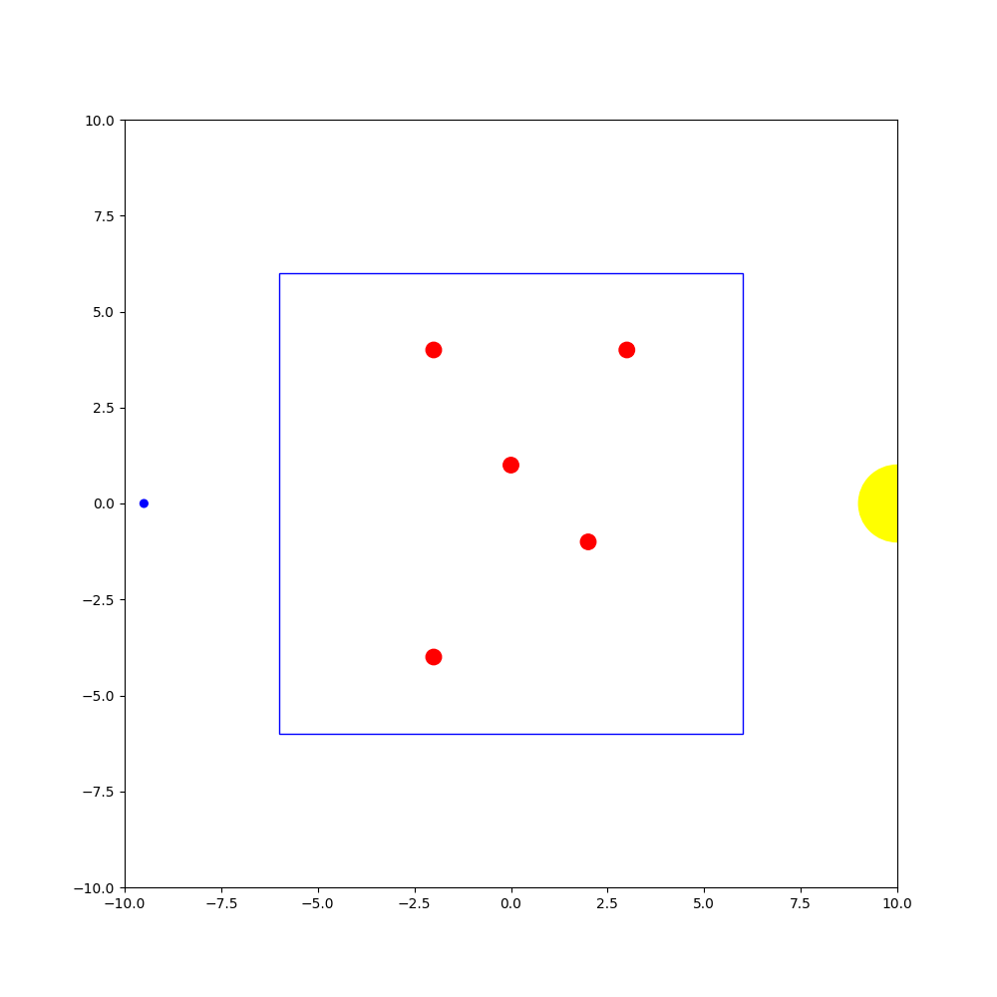
How to test?

Slide 14
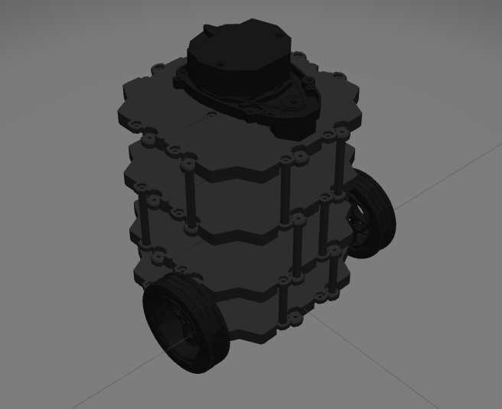
How to test?
10x10 Working-Area
Obstacles
Cylinders
limited space
varying (constant) velocities
2 simulations

Slide 15
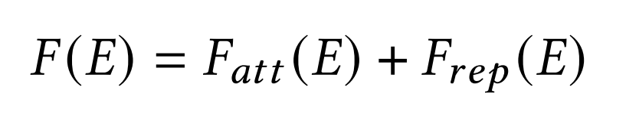
Models
Classic APF
Forward APF
Rotational FAPF
Improved APF

Slide 16
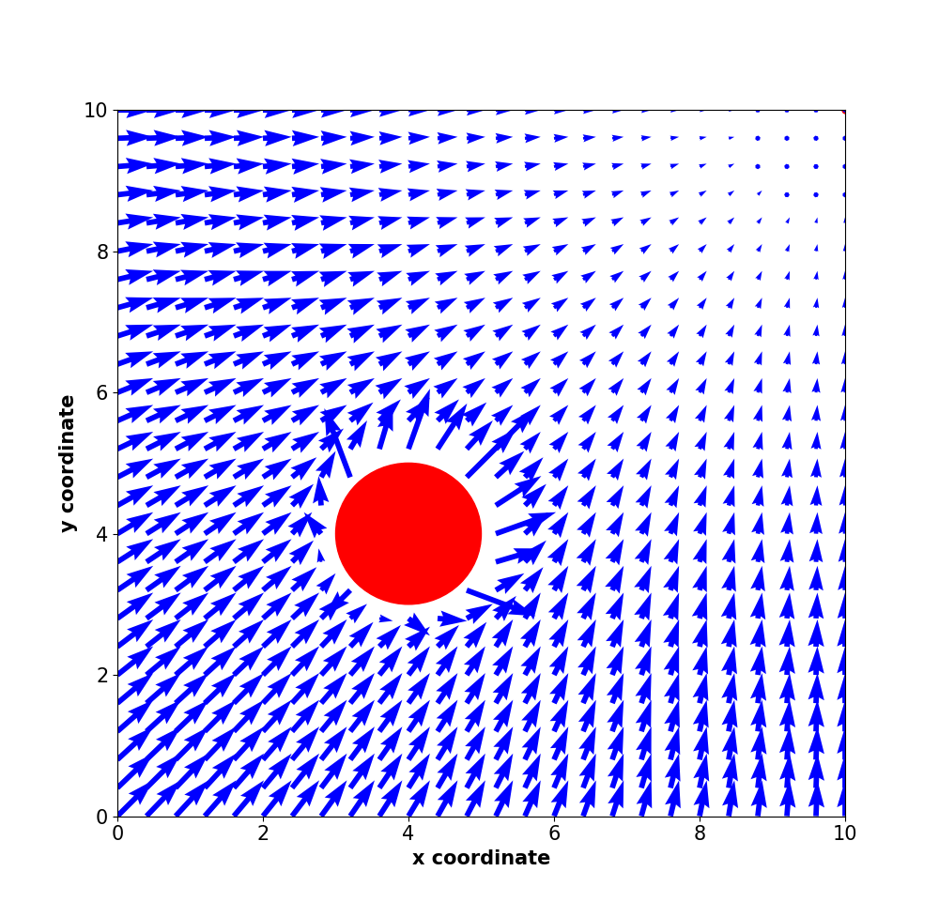
Classic APF

Slide 17
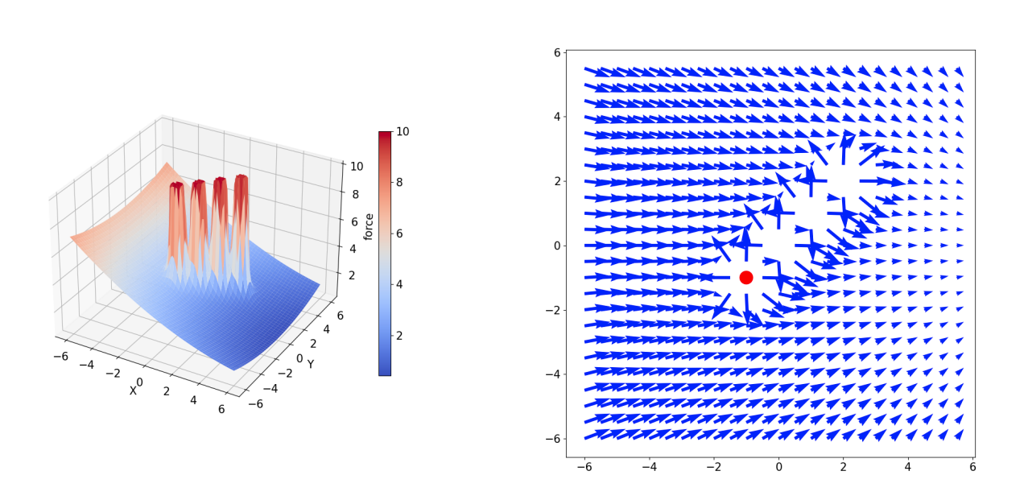
Forward APF

Slide 18
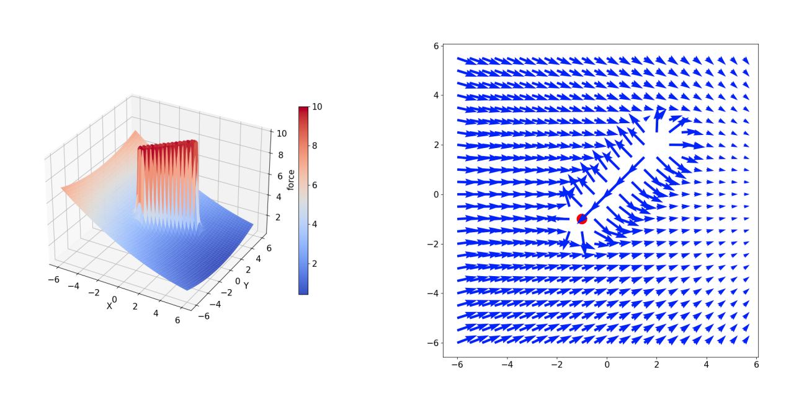
Forward APF

Slide 19
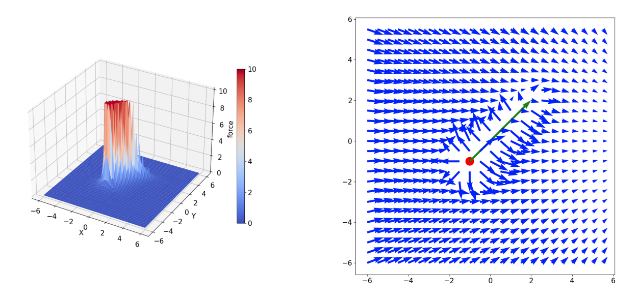
Forward APF

Slide 20
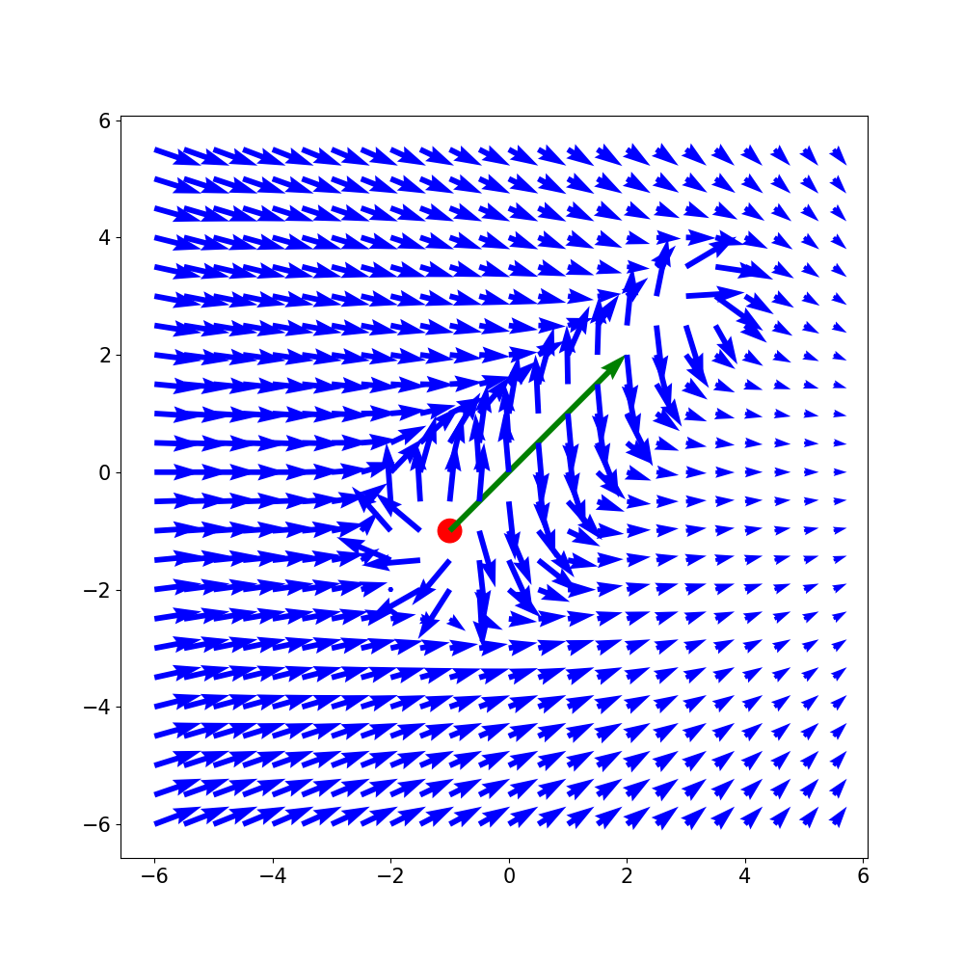
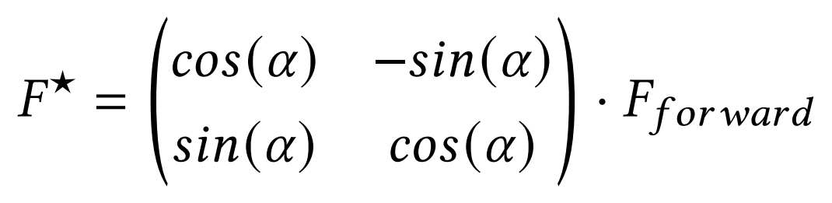
Rotational APF

Slide 21
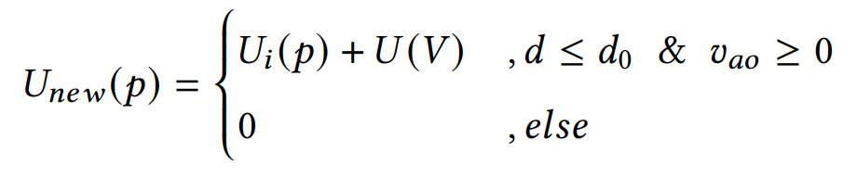
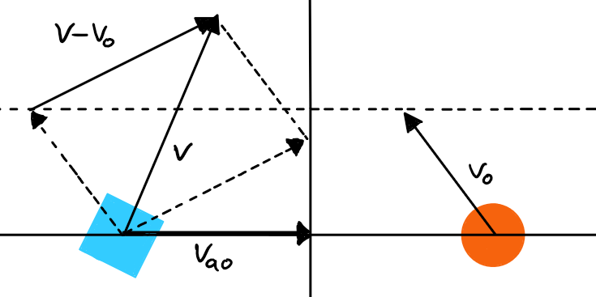
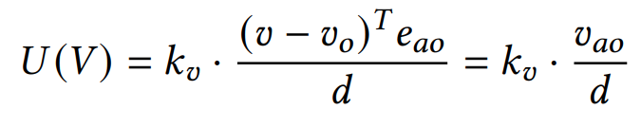
Improved APF

Slide 22
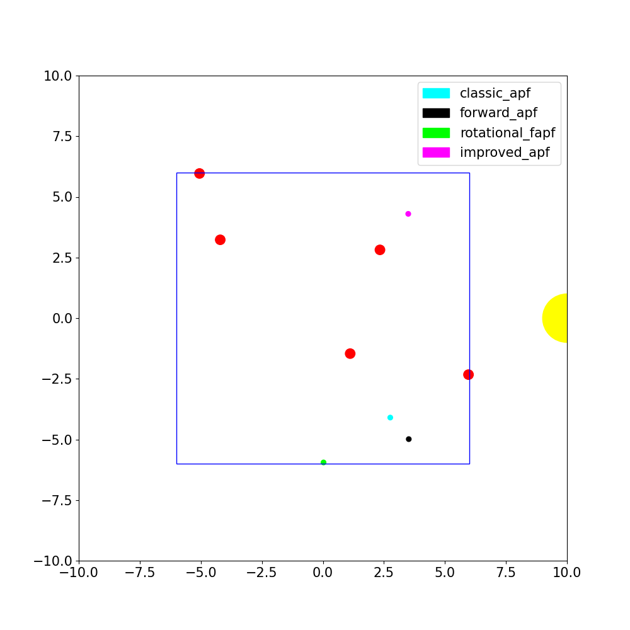
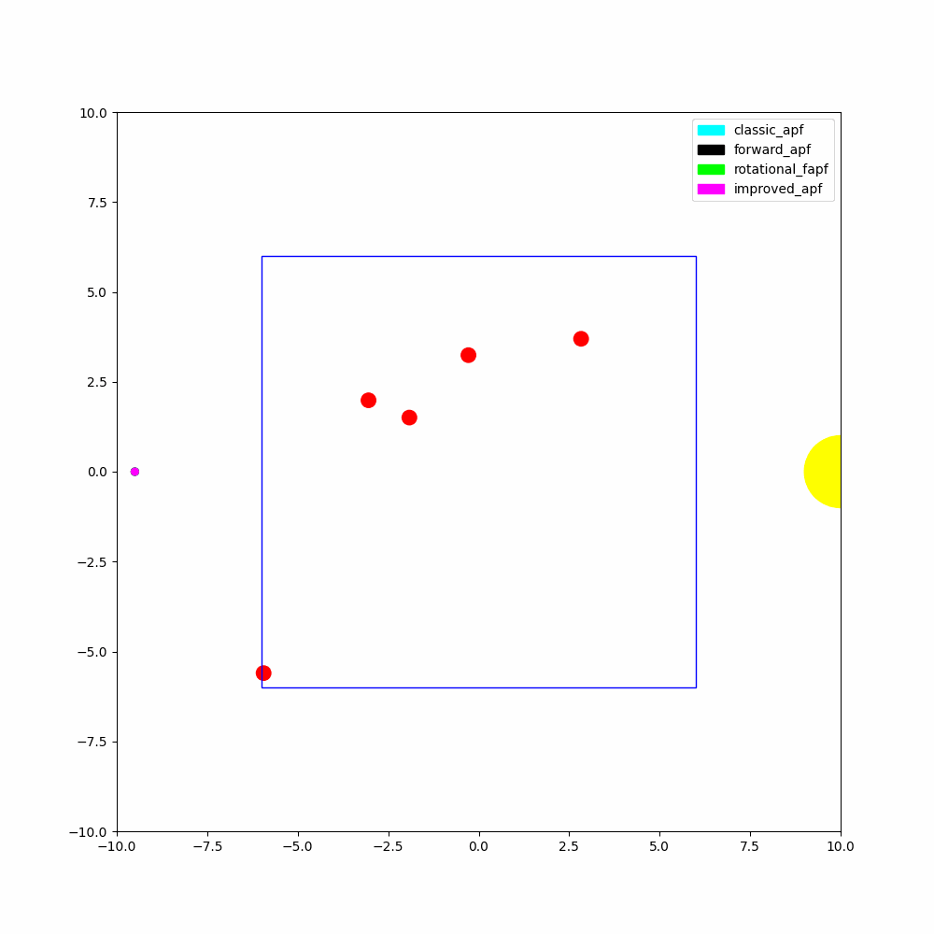
Theoretical Simulation
Start: (-10,0)
Goal: (10,0) ± 1
Robot:
Size: 0.1
no movement constraints
Obstacles:
Border: 6x6 square
Size: 0.2

Slide 23
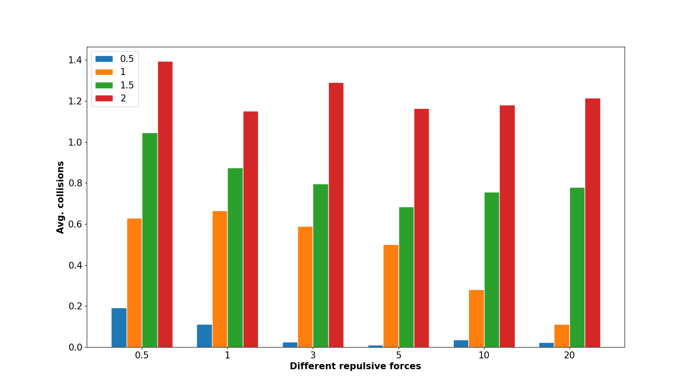
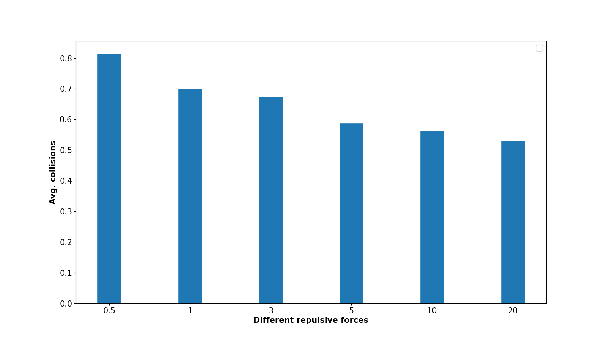
Results – Classic APF

Slide 24
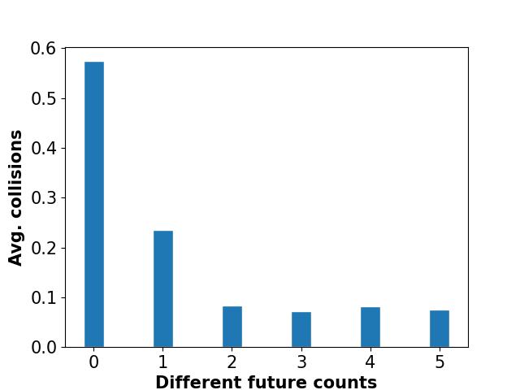
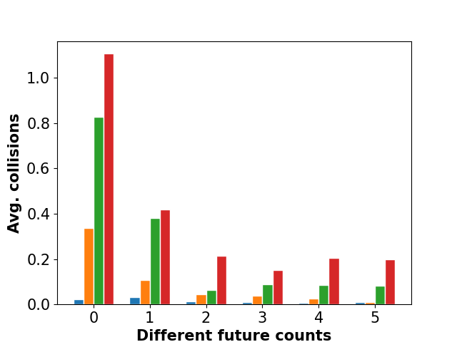
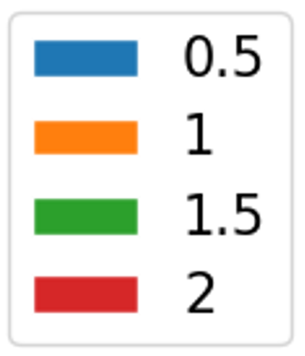
Results – Forward APF

Slide 25
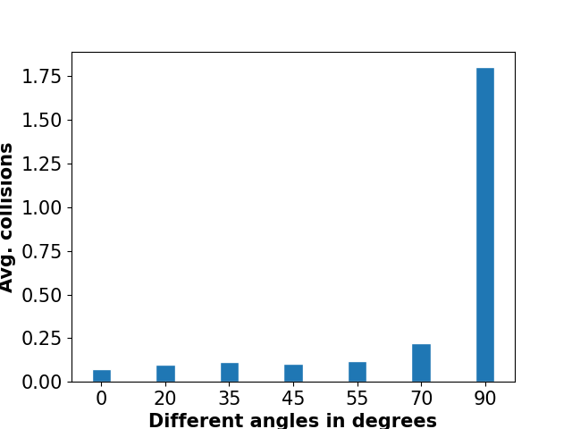
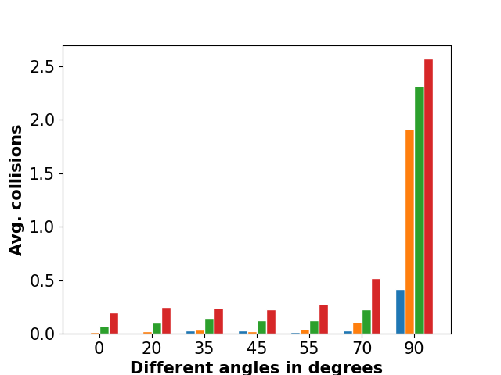
Results – Rotational FAPF

Slide 26
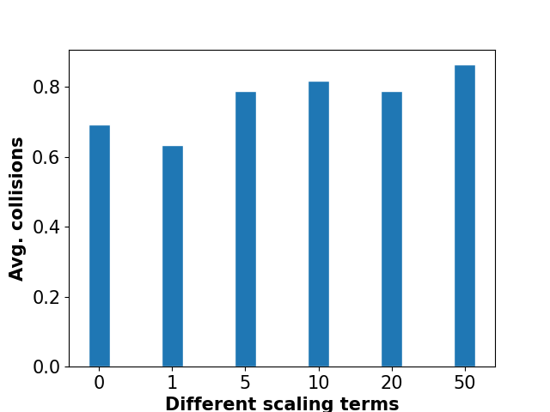
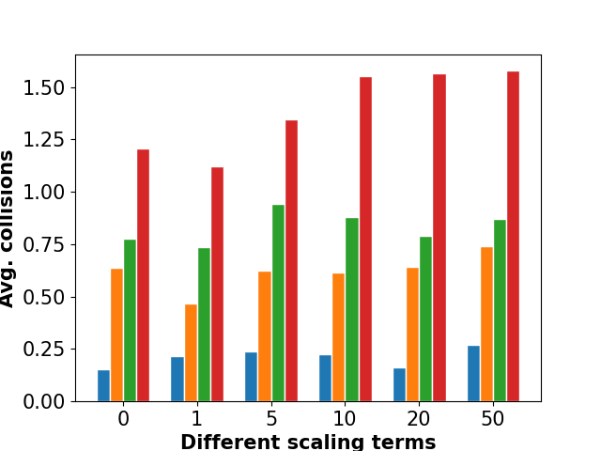
Results – Improved APF

Slide 27

Interim Evaluation

Slide 28


Gazebo Simulation
ROS
Gazebo

Slide 29

Setting
Start: (-10,0)
Goal: (10,0) ± 3
Robot:
1 m/s + nonholonomic
Obstacles:
Border: 5x5 square
Size: 0.2
Vel: 1 & 2 m/s

Slide 30

Example

Slide 31


Results

Slide 32



Additional Tests

Slide 33


Slide 34


Slide 35

Results
Classic APF
Forward APF
Rotational APF
Improved APF

Slide 36

Results
Classic APF
Forward APF
Rotational APF
Improved APF

Slide 37

Results
Classic APF
Forward APF
Rotational APF
Improved APF

Slide 38

Additional Tests - Results

Slide 39

Evaluation
Theoretical Simulations
Gazebo Simulation

Slide 40
Quellen
https://www.autocar.co.uk/sites/autocar.co.uk/files/styles/gallery_slide/public/images/car-reviews/first-drives/legacy/20_robot-delivery-2021-olg-1729.jpg?itok=XHzNXW1J
https://evmojo.com/wp-content/uploads/2020/06/autonomous-car-detecting-surroundings.jpg
https://www.springwise.com/wp-content/uploads/2019/03/Springwise_mars_rover_Tech_explained_1280x750.jpg
https://cdn.nmbtc.com/uploads/2021/11/warehouse-robots-blog-hero-e1638225177167.png
https://www.binghamton.edu/news/images/uploads/features/maze.jpg
https://as1.ftcdn.net/v2/jpg/01/07/12/78/500_F_107127855_L5HV9pl7c0WKeFyHOGxlDCXVRlkn4qpG.jpg
https://d3i71xaburhd42.cloudfront.net/b78da75686e9630ec97bd41fe317434d219a727f/5-Figure4-1.png
https://ars.els-cdn.com/content/image/1-s2.0-S1568494621005263-gr4.jpg

